Slide 1
Thesis Progress Update (1/3)
Joud Sayed Issa
03-05-2019

Slide 2
Outline
Study Question
Data Preparation Process

Slide 3
STUDY QUESTION
In the adult ICU patients with Heart Failure (sepsis), is the exposure to the beta blocker associated with the development of Acute Kidney Injury (AKI) than the people who doesn't take beta blocker ?

Slide 4
TABELS IN MIMIC-III
26 Tables & 53,423 distinct hospital admissions for adult patients
ADMISSIONS
CALLOUT
CAREGIVERS
CHARTEVENTS
CPTEVENTS
D_CPT
D_ICD_DIAGNOSES
D_ICD_PROCEDURES
D_ITEMS
D_LABITEMS
DATETIMEEVENTS
DIAGNOSIS_ICD
DRGCODES
ICUSTAYS
INPUTEVENTS_CV
INPUTEVENTS_MV
LABEVENTS
PATIENTS
PRESCRIPTIONS
PROCEDUREEVENTS_MV
PROCEDURES_ICD
SERVICES
TRANSFERS

Slide 5
DEMOGRAPHICS
The following demographic/administrative variables were extracted to be used as predictors:
age at ICU admission,
gender,
admission type (elective, urgent, emergency),
and first ICU service type of the ICU admission (Current service).

Slide 6
VITAL SIGNS
Furthermore, the first measurement in the ICU of the following vital signs and lab tests was each extracted as a predictor:
Heart rate,
Mean and systolic blood pressure (invasive and noninvasive measurements combined),
Body temperature,
SpO2,
respiratory rate,

Slide 7
LAB TESTS
Creatinine,
Potassium,
Sodium,
Chloride,
Bicarbonate,
Hematocrit,
White blood cell count,
Glucose,
Magnesium,
Calcium,
Phosphorus,
Lactate.

Slide 8
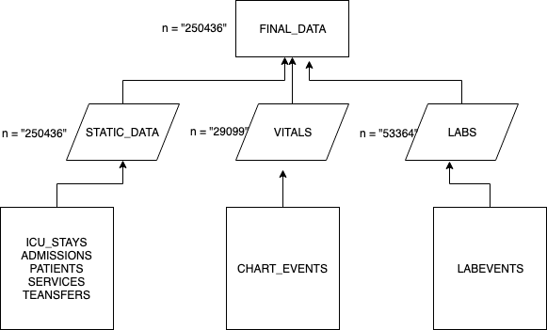
Demographics, Labs, Vitals signs

Slide 9
Patients with Sepsis
To extract the patients who are considered to have sepsis, we should depend on the sepsis signs ( diagnostic criteria) to catch most of the cases
This is defined as pre-defined materialized for sepsis concept in the “MIT-LCP” official repo
They defined three main criteria for sepsis patient selection (angus, explicit, martin)
We followed the angus criteria as it is the broader one in defention.

Slide 10
Angus Criteria for Sepsis Patient Selction (1)
To identify cases with severe sepsis, we selected all acute carehospitalizations with ICD-9-CM codes for both:
a bacterial or fungal infectious process AND
(b) a diagnosis of acute organ dysfunction
Refrence : Angus et al, 2001. Epidemiology of severe sepsis in the United States http://www.ncbi.nlm.nih.gov/pubmed/11445675

Slide 11
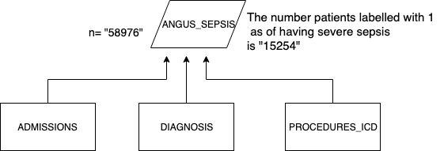
Angus Criteria for Sepsis Patient Selction (2)

Slide 12
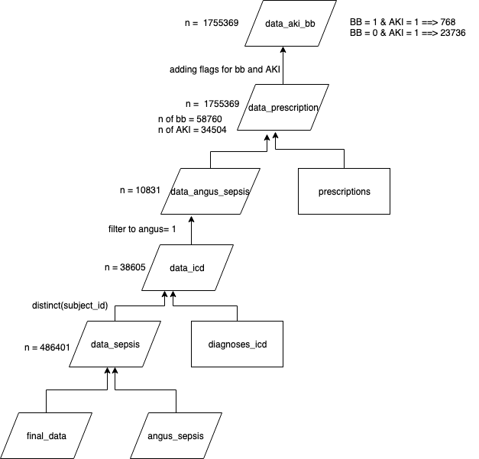
Putting It All Together
I added
icd-9 code
Drug_name_generic

Slide 13
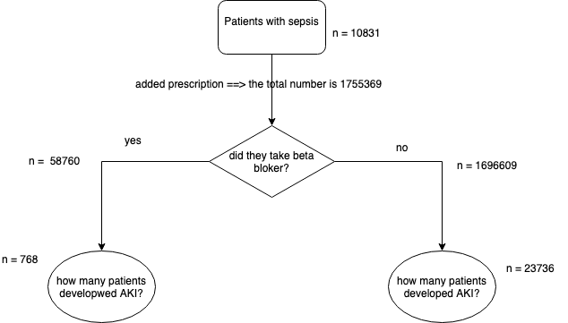
Selection Criteria

